Slide 1
NORTHWIND TIME SERIES ANALYSIS AND FORECASTING
PRESENTED
BY
OLANIYAN KAFAYAT OWOSENI
(Olaniyan.kafayat@yahoo.com)
ON
DATA SCIENCE CAPSTONE PROJECT
TOOL STACK :PYTHON, SQL, POWERBI
DATE:JUNE 27TH2025

Slide 2
PROJECT OVERVIEW
To explore and analyze the Northwind dataset to understand key business operations including sales, customer behaviors, employee performance, and supply chain activities
• Data Collection & Cleaning
• Exploratory Data Analysis (EDA)
• Modeling
• Visualization
• Decision Making

Slide 3
OBJECTIVES
Deepen my knowledge in real world data modeling and analytics
Gain hands-on experience in predictive modeling and time series forecasting
Contribute valuable insights to ongoing data projects

Slide 4
PROJECTS AND TASKS WORKED ON
ARIMA Time Series forecasting
Analyze sales trends using the Northwind datasets
Used ARIMA to forecast future values and presented key findings
Moving average
Use for very simple data smoothing or short -time forecasting
Exploration analysis

Slide 5
Exponential smoothing
Short-to-medium term forecasting
Time series with trend and/or seasonality
Compared the moving average and exponential smoothing with the ARIMA results for performance insights.
Dashboard creation
Built interactive dashboards in power BI to visualize key metrics
Used SQL to extracts and clean data for reporting

Slide 6
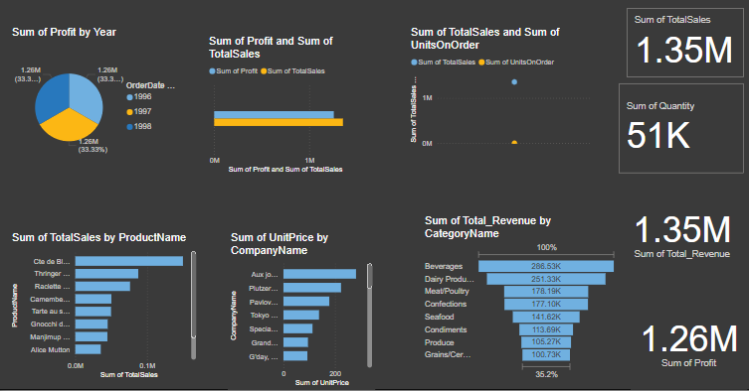

Slide 7
KEY ACHIEVEMENTS
Delivered accurate predictive models with measurable results
Create easy-to –understand dashboards for non-technical stakeholders
Contributed to decision-making processes through actionable insights

Slide 8
SKILLED GAINED
Technical : Python, SQL, power BI ,ARIMA, Moving Average, Exponential Smoothing
Soft Skills : Communication, teamwork, problem-solving, presenting findings
Domain : Sales forecasting, data story tellings and stakeholder reporting

Slide 9
CHALLENGES AND SOLUTION
Challenges
Data cleaning and formatting inconsistence
Choosing the right forecasting model and visuals for the dashboard creation
Solutions
Applied advanced pandas techniques and regular expressions
Compared model performance using MAE and RMSE scores

Slide 10
WHAT’S NEXT
Continue refining models with larger datasets
Explore deep learning applications in time series
Work on end-to-end deployment of models (e.g., with Flask or Streamlit)

Slide 11
CONCLUSIONS
Our time series analysis successfully identified seasonal patterns and trends components within the data
Forecasting accuracy improvements translated to annual cost savings
Real-time anomaly detection enables proactive response to market shifts
Seasonal adjustment factors now inform inventory and staffing decisions
Model interpretability provides actionable insights for stakeholders
Development of interactive dashboards for business users to access forecasts and insights

Slide 12
THANKS FOR LISTENING

